Slide 1
Where is the …?

Slide 2
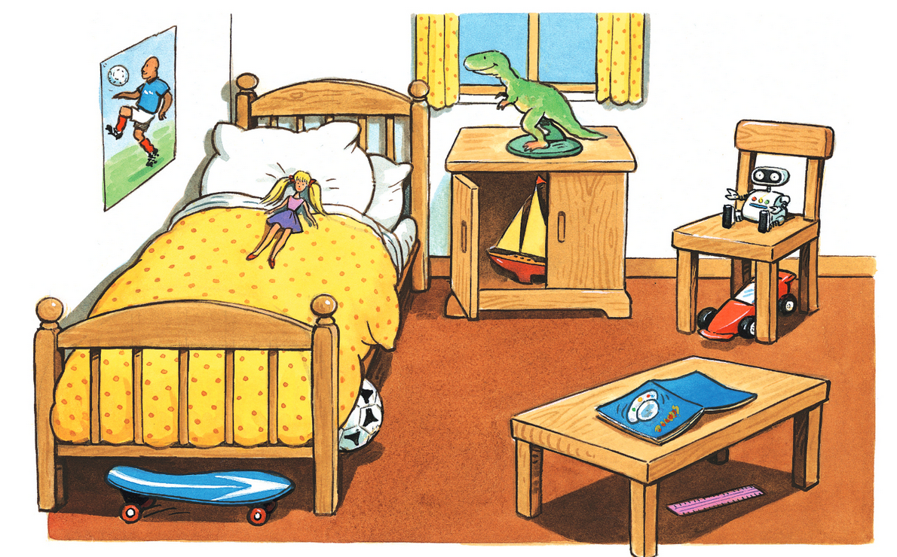
Where is the ball?
Where is the boat?
Where is the book?

